Slide 1
GIT use for ProdGSI
Guoqing Ge
My GIT experiences:
Support ProdGSI (GSI/EnKF) community through DTC
Maintain four Real-time 3DRTMA runs and HRRRx variants using GIT
Example special use cases:
track multiple remotes
track Vlab and Github at the same time
track multiple Github accounts (use multiple SSH keys)
Git under a group (role) account
Push only current branch
why .gitignore does not work?
Github password-less access
undo "git add" or "git commit"
.git needs to be located in another location to save disk space
merge your changes without a fast-forward

Slide 2

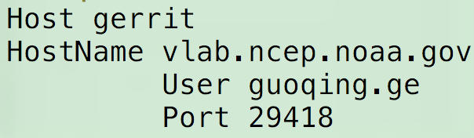
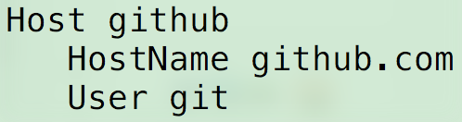
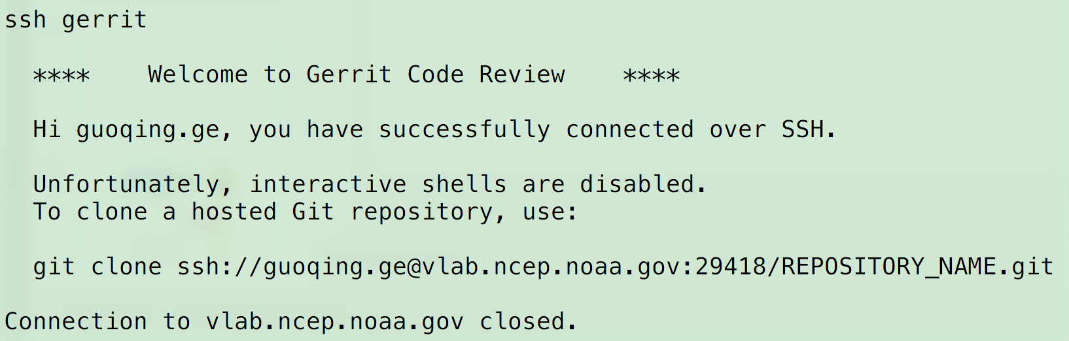
Preparation for GIT with ProdGSI
--Set up connection to Vlab gerrit
1. Create a “gerrit” host entry in the .ssh/config file
You can also create a “github” entry similarly.
2. Copy your public ssh key to gerrit website
https://dtcenter.org/com-GSI/BUFR/ProdGSI_SSH_123.pdf
3. Test your connection (ssh gerrit)

Slide 3
Redmine
https://vlab.ncep.noaa.gov/redmine/projects/comgsi
Redmine provides developers with wiki, forum and issue tracking functionality.
Wiki, check branches, compare codes
Gerrit
https://vlab.ncep.noaa.gov/code-review/
Code host, Code review, user management

Slide 4
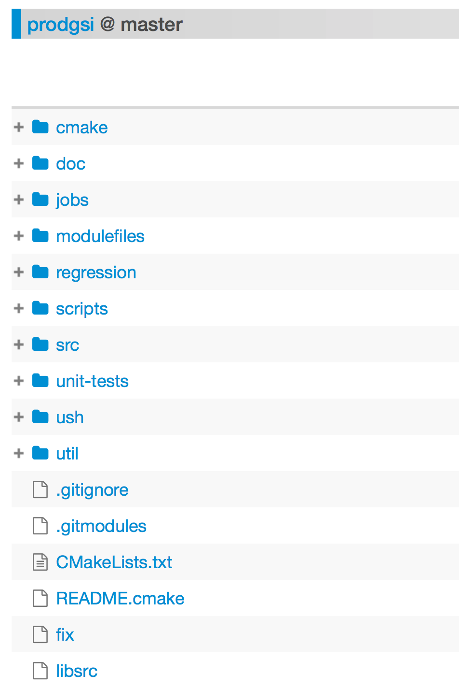
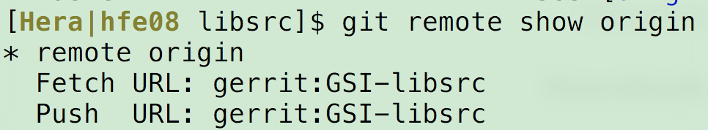
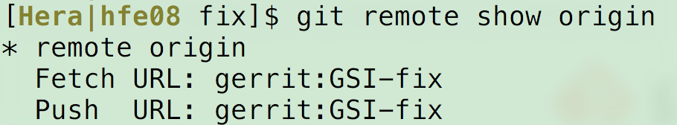
fix/ and libsrc/ are submodules
Submodules allow you to use another Git repository as a subdirectory of ProdGSI repository.

Slide 5
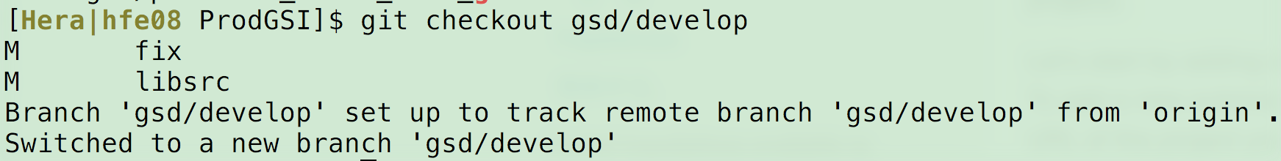
a full clean copy of ProdGSI
git clone --recursive gerrit:ProdGSI
5.8G, takes a few minutes depending the network speed
ProdGSI already existed, check out another branch (e.g. gsd/develop)
git fetch
Fetch all changeset information from Gerrit
git checkout gsd/develop
git submodule update [fix | libsrc]
git status

Slide 6
Check what’s current branch
git branch
git checkout gsd/develop
git submodule update
Create a new branch before making your changes
git checkout -b gsd/haidao-abi
Contact Ming before committing changes to gsd/develop
Commit changes and push to Gerrit
git add <files>
git status
git commit -m “this is commit message”
git push (git push –u origin gsd/haidao-abi if it is the first push)
git status

Slide 7
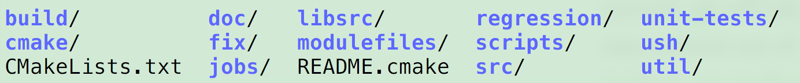
ProdGSI/
.git/index
.git/objects/
Vlab gerrit
Or Github
Notes:
The extra step give you extra freedom to fine-tune your changes before final commits
One interesting metaphor: you can think stage is the process to magically turn the changed files into stone and repo only receive different stones.
Staging is a step before the commit process in git. That is, a commit in git is performed in two steps: staging and actual commit.
As long as a changeset is in the staging area, git allows you to edit it as you like (replace staged files with other versions of staged files, remove changes from staging, etc.).

Slide 8
1. track a particular file
git log -- <file> or git log --follow -- <file>
git log -20 (recent 20 commits)
2. only push the branch you are on:
git config remote.origin.push HEAD
3. .gitignore is very important
tutorial: https://www.atlassian.com/git/tutorials/saving-changes/gitignore
4. Github password-less access:
(1) add ssh public key to github website
(2) replace "https://github.com/"" with "git@github.com:/"
5. "Git stash" is very helpful to get a clean working copy instantly.
6. undo a "git add"----unstage changes before "git commit"
git reset <file>
undo working copy: git checkout -- . Or git checkout -- <file>
undo stage and working copy: git reset --hard
tips

Slide 9
7. undo recent not-pushed commits:
git reset --hard HEAD^ (remove the last commit)
git reset --hard HEAD~2 (to remove the last two commits)
8. default .git directory can be changed (or linked)
9. solve conflicts from git merge
search "<<<<HEAD" inside conflict files
10. git config --global user.email "you@example.com"
git config --global user.name "Your Name"
Github and VLab uses different user names
11. checkout a specific file from another branch
git checkout gsd/develop -- src/setuppw.f90
git show gsd/develop:src/gsi/setuppw.f90 > tmp.txt
12. git fetch vs git pull
13. find out which remote branch a local one is tracking
git branch -vv
14. git branch -r (|grep -i “map”) ## search a branch
tips

Slide 10
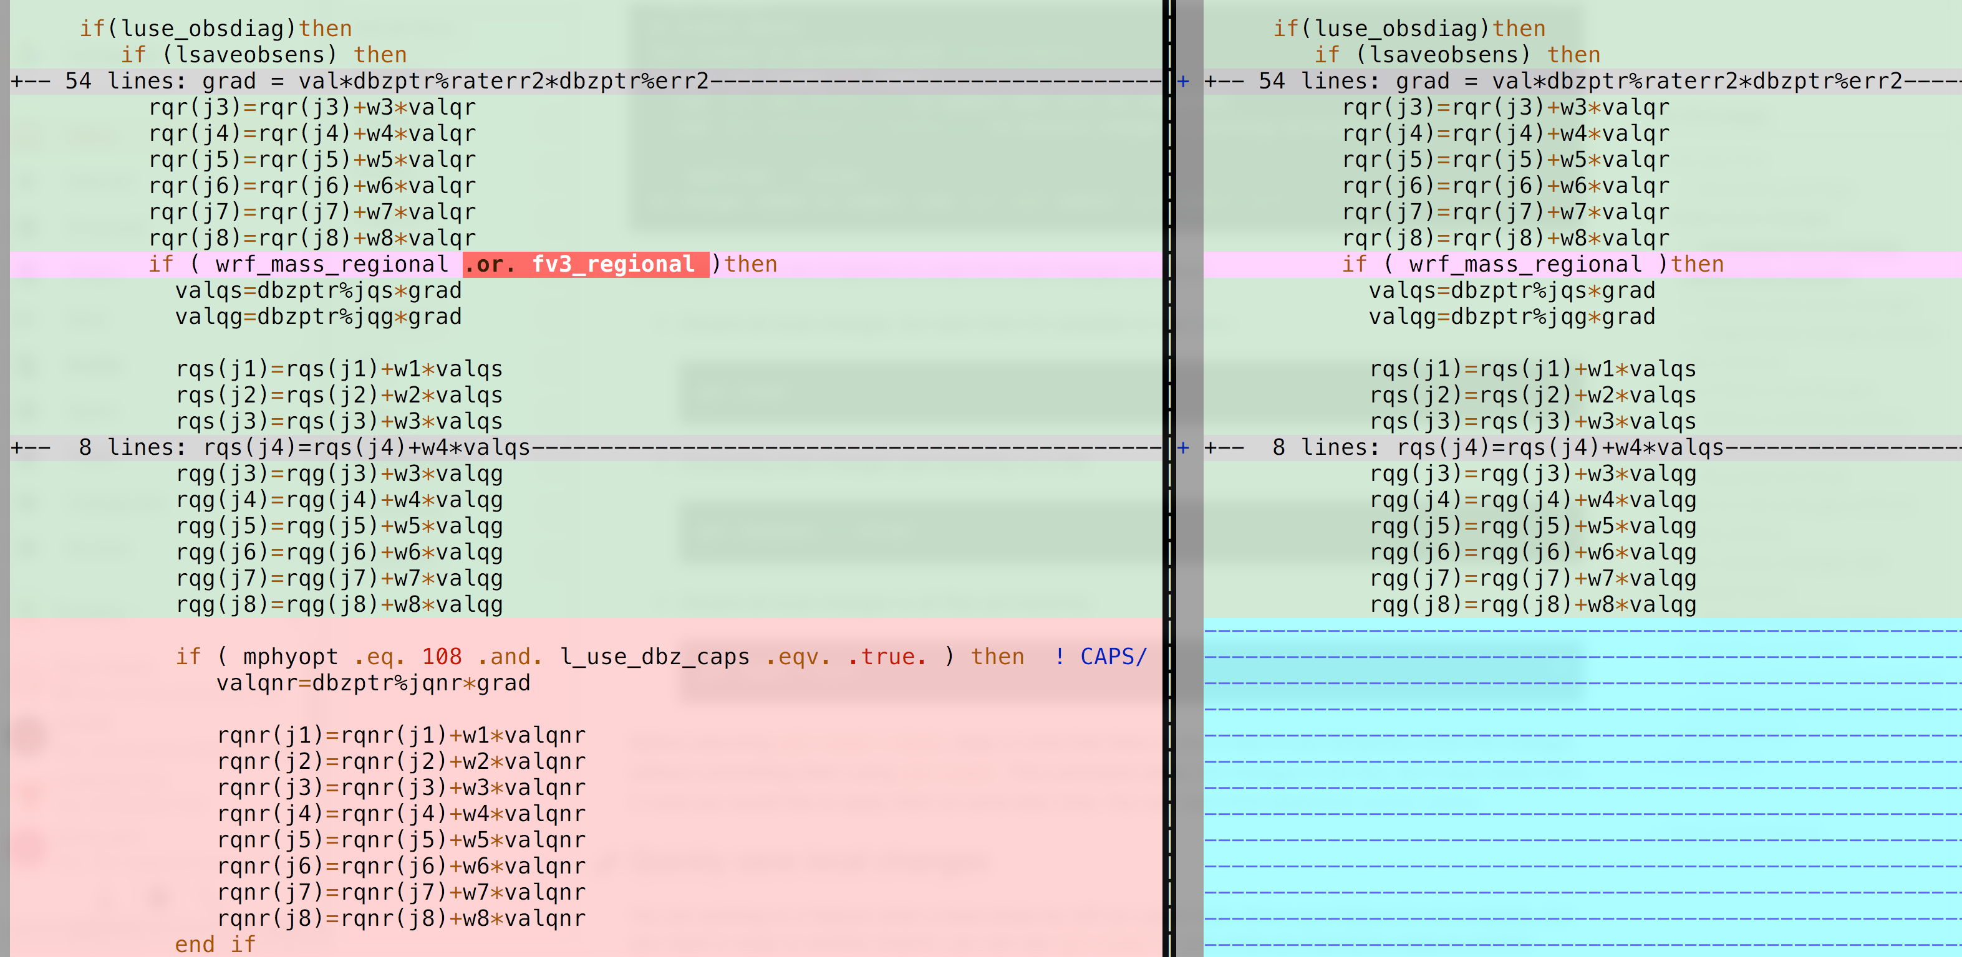
git vimdiff
git config --global diff.tool vimdiff git config --global difftool.prompt false git config --global alias.vimdiff difftool
git checkout GSI-CAPS
git diff --name-only HEAD HEAD~1
git diff HEAD HEAD~1 src/gsi/intdbz.f90
git vimdiff HEAD HEAD~1 src/gsi/intdbz.f90
Similar view as from Redmine

Slide 11
GIT Test Drive:
git clone gerrit:rt-sandbox

Slide 12
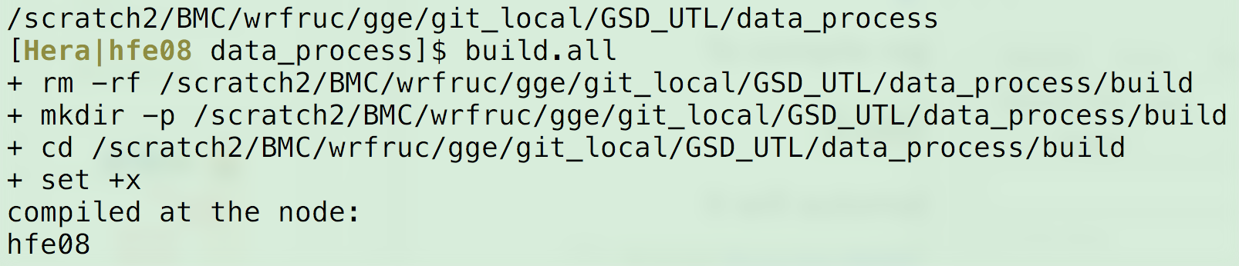
bonus
How to compile ProdGSI:
To compile regional ProdGSI on Hera, Jet, Cheyenee, Orion
$ ush/build.comgsi
It will automatically load required modules and do compiling with appropriate parameters
$ source /home/rtrr/PARM_EXEC/modulefiles/modulefile.hera.GSI_UPP_WRF
$ cmake -DENKF_MODE=WRF -DBUILD_GSDCLOUD_ARW=ON -DBUILD_ENKF_PREPROCESS_ARW=ON -DBUILD_UTIL_COM=ON .. 2>&1 | tee output.cmake
How to compile GSD_UTL:
Under GSD_UTL/data_process:
$ build.all
Git under rtrr
http://bit.ly/rtrrgit

